Slide 1

Implementation of quiz using java

Slide 2

Team members D . Sampath reddy A . Sameer reddy Ch. Vamsi Krishna

Slide 3


Introduction
Instead of the regular pen-paper examinations held by various institutions, one can make use of the Quiz Portal. Quiz Portal makes education fun and easier
The main intend of the Online Quiz is to successfully approximate the applicant entirely via a totally computerized structure which besides preserving time, offers swifter outcomes. Normally, pupils are provided with paper, pen, etc for taking the examination but the Online Quiz does not necessitate all these.

Slide 4

Features
Taking online quizzes makes it possible to have a large number of participants. It could be up to a number of 1000 participants (and even more!).
It doesn’t matter at what kind of location they take the online quiz as long as they are connected to the Internet.
It is significantly easier to randomize your question with just one click than to do it all manually.

Slide 5
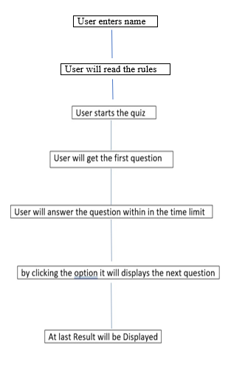
ARCHITECTURAL DESIGN

Slide 6
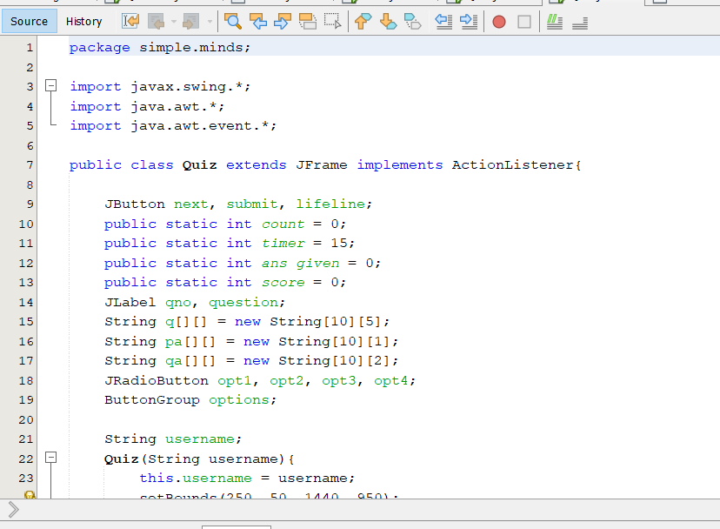

Slide 7
Software used
Java JDK "16.0.2“
Netbeans IDE 12.5

Slide 8
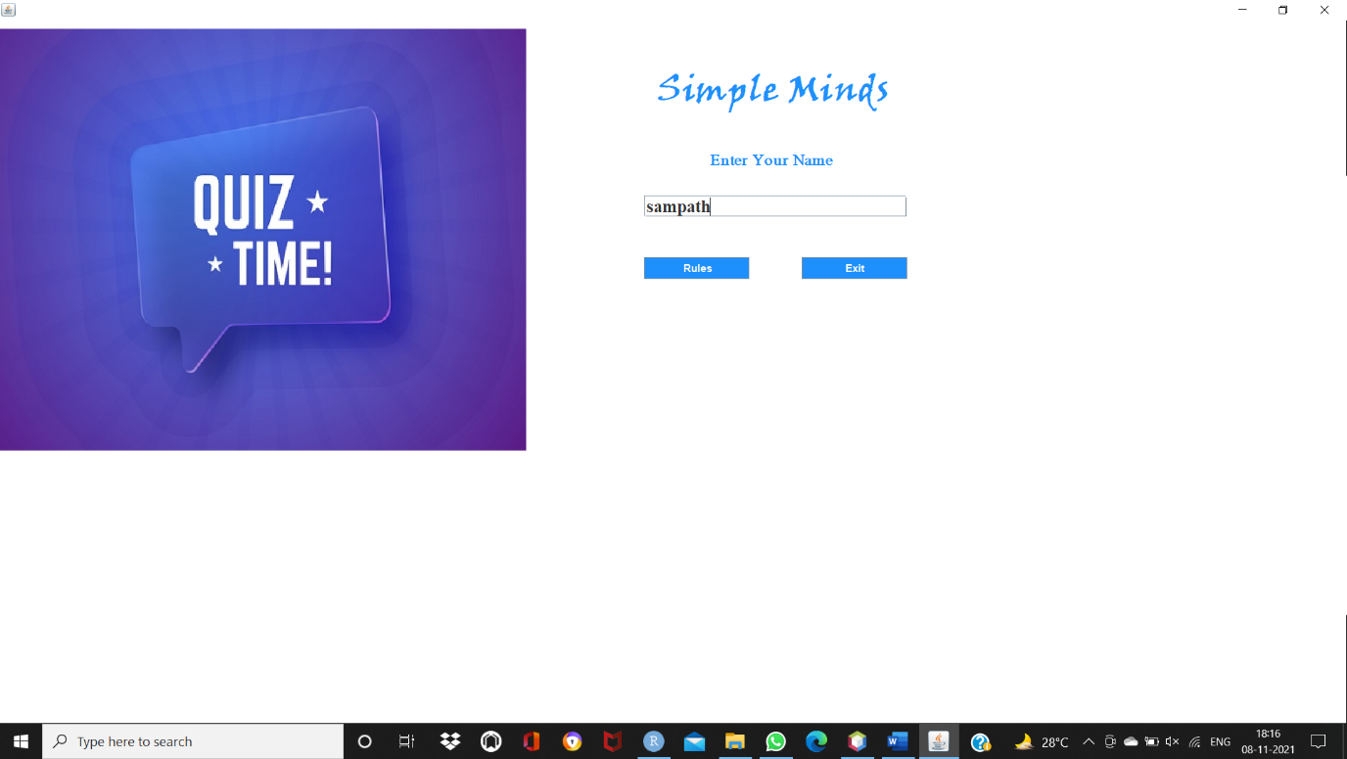
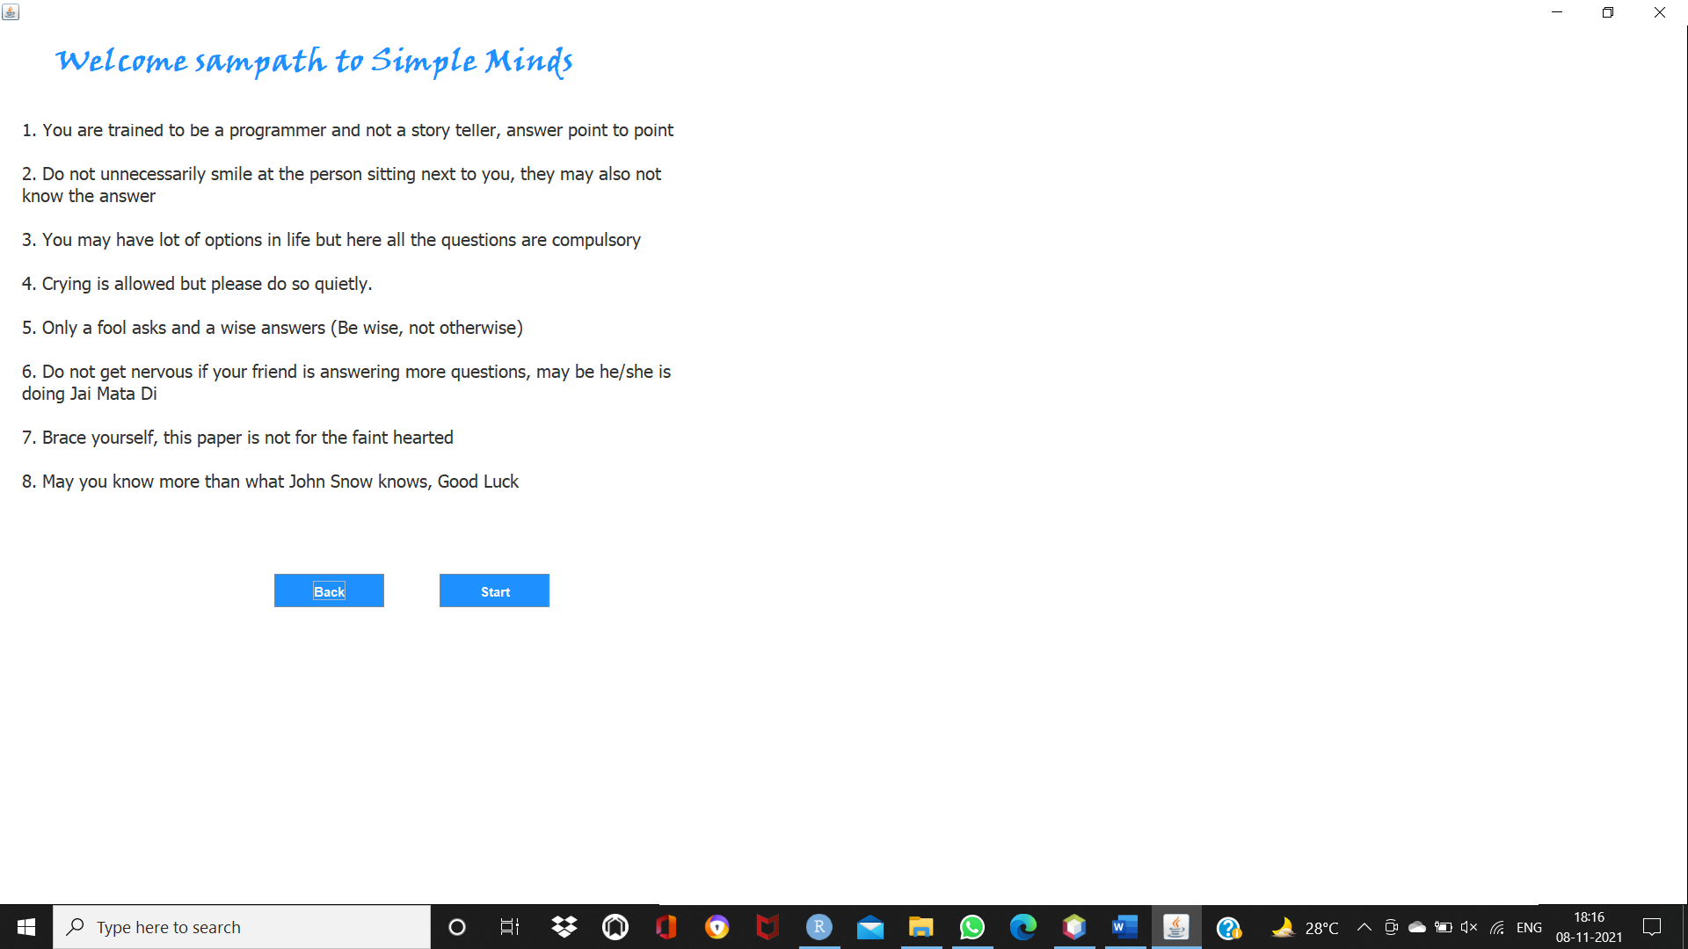
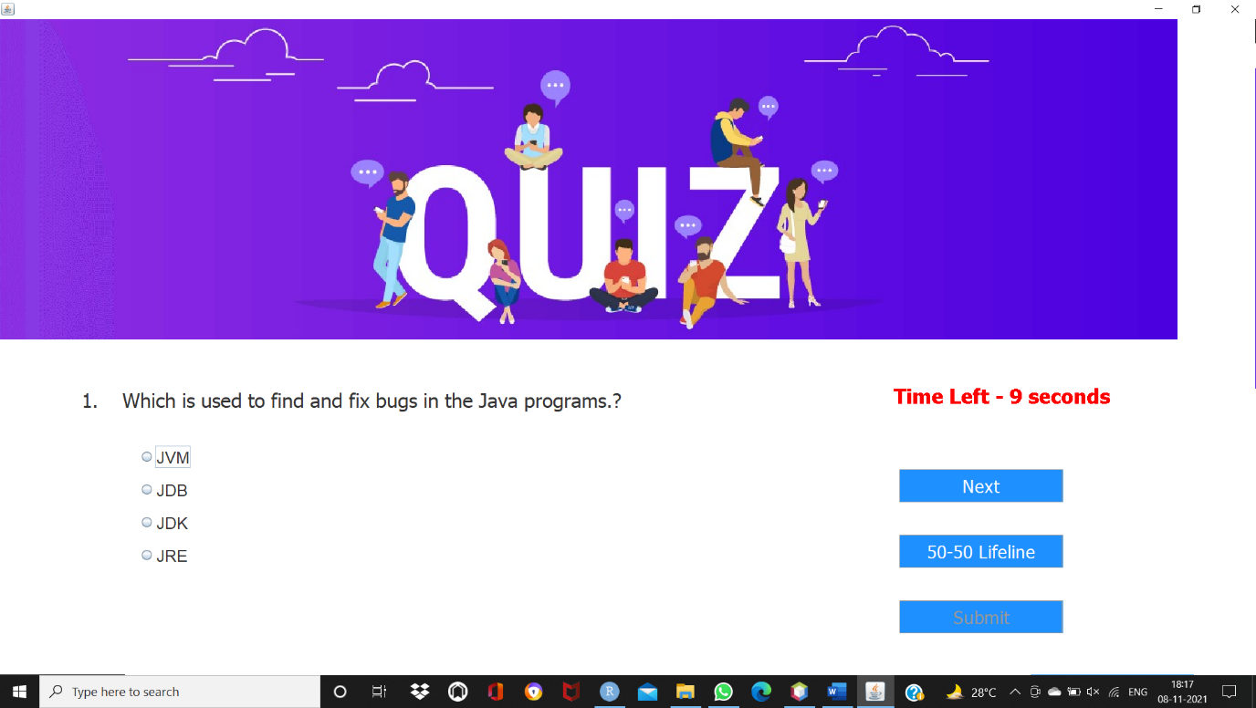
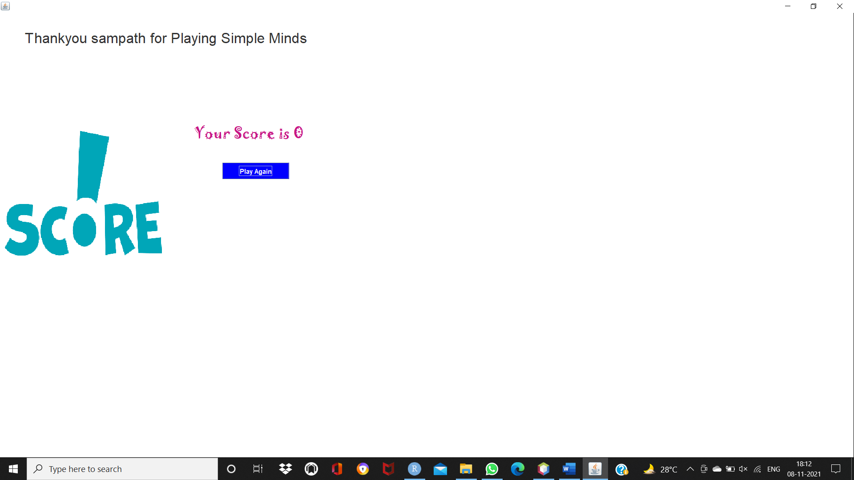
Output

Slide 9


